Slide 1

Event-Driven Smart Surveillance & Security Hub
Using ESP32-CAM module and Multimodal AI.
BATCH NO: 1
PROJECT GUIDE
A. Shiva (24P81A0401) | B. Sai Charan (24P81A0408)
D. Mythri (24P81A0416) | G. Karthikeya (24P81A0419)
K. Krishna Sri (24P81A0430)
Mr. S. Venu Prasad
(Assistant Professor)

Slide 2
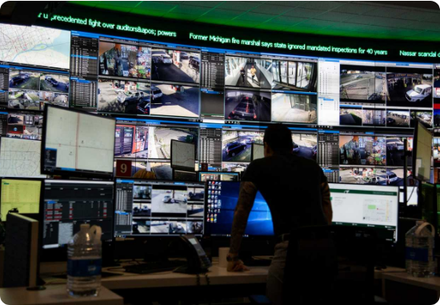
The Limitations of
Traditional Surveillance
Resource Intensive
Traditional systems heavily rely on continuous video streaming, wasting infrastructure capabilities.
High Costs
They require extremely high network bandwidth and extensive local or cloud storage capacities.
Human Fatigue
They necessitate constant human monitoring, which is prone to fatigue and oversight.
Lack of Context
Conventional systems only trigger generic alarms upon motion, without providing context regarding the actual threat.

Slide 3
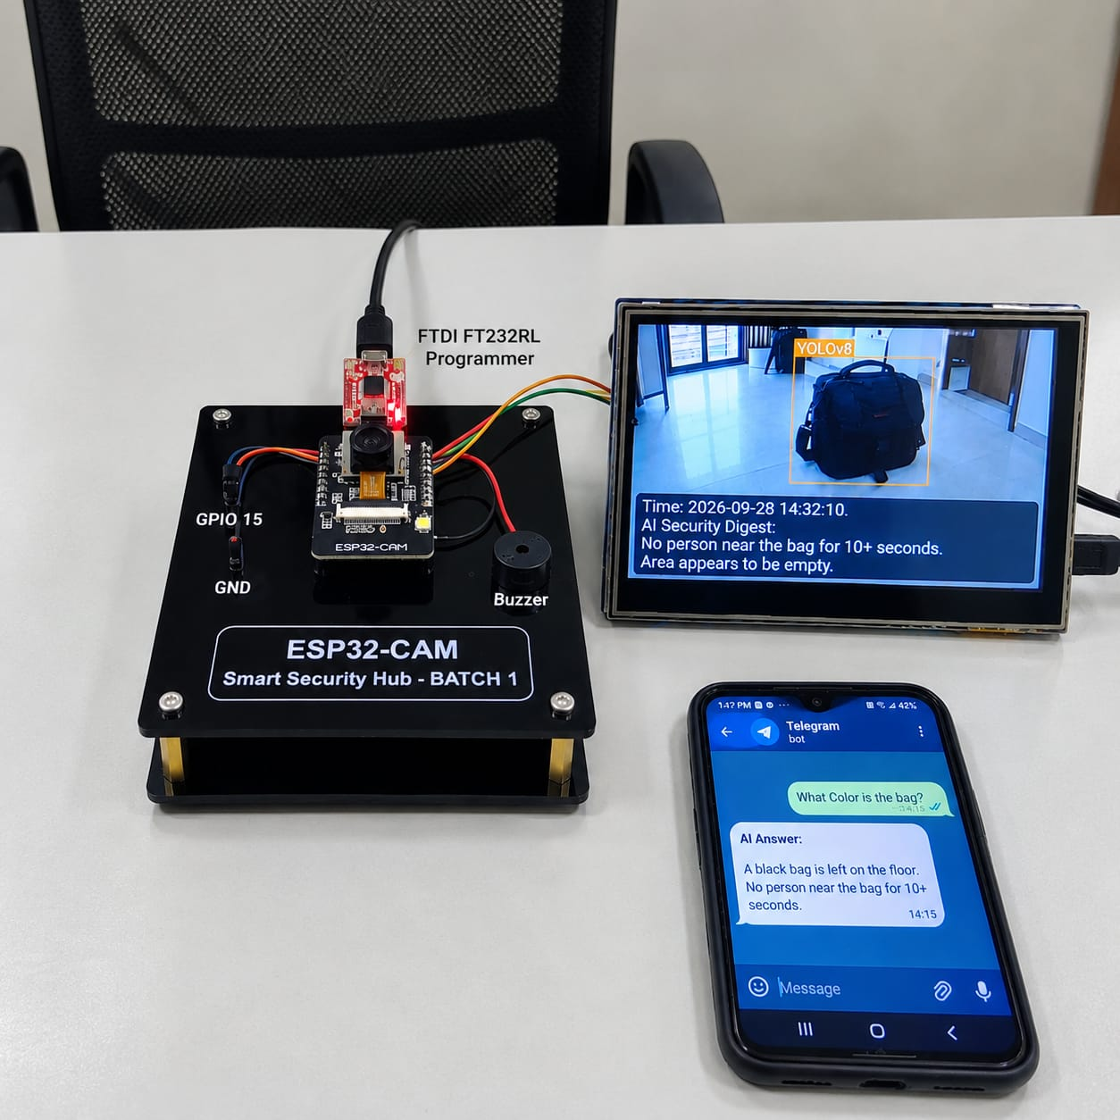
INTELLIGENT, REAL-TIME THREAT ANALYSIS
The Solution
We present an event-driven, smart security hub engineered to optimize resource utilization.
[ Project Photo Placeholder ]
The architecture purposefully divides computational labor between low-power edge hardware for detection and a high-performance Python central backend for analysis.
Instead of generic sirens, the system generates a natural-language security digest detailing the exact nature of the event, pushing actionable intelligence to the user.

Slide 4
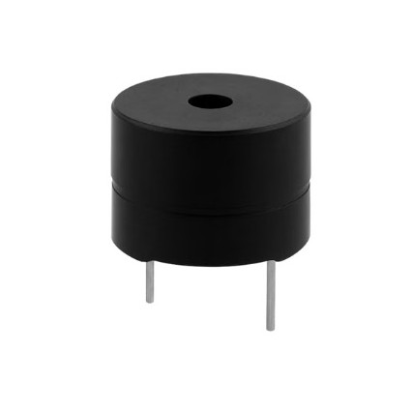
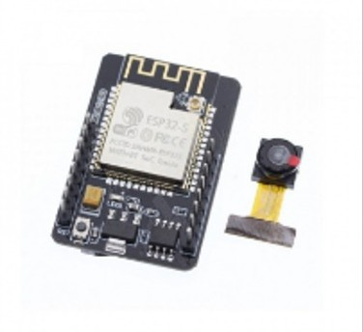
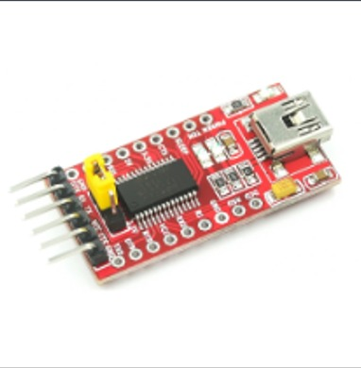



Hardware Components
ESP32-CAM (OV2640 2MP)
FT232RL FTDI Adapter
5V Active Alarm Buzzer
Acts as the highly effective camera, captures, and transmits over Wi-Fi.
The critical programming interface utilized to upload code and establish serial communication.
It responds on command from the Telegram bot for physical deterrence.

Slide 5
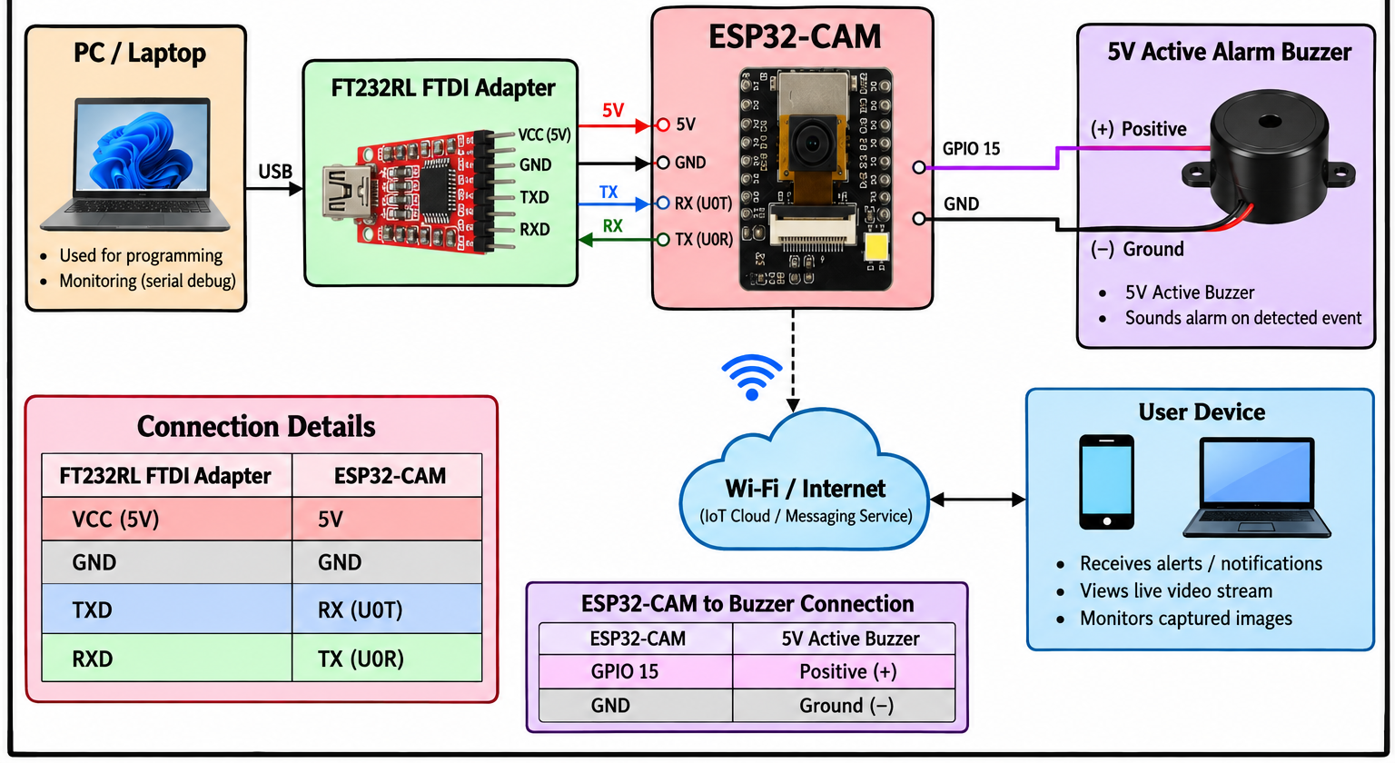
Block Diagram

Slide 6






Multimodal AI & Communication
YOLOv8
Moondream (Ollama)
Telegram API
Provides zero-latency spatial tracking. Detects humans and target objects to calculate proximity and state transitions.
Lightweight 1.8B vision-language model. Processes visual frames into natural language incident digests on-device.
/status: Live AI summary.
/history: Export DB logs.
/buzzer: Remote hardware alarm.
/arm & /disarm: Toggle loop.
VQA: Ask questions via chat.
Python 3.14
Aurdino IDE
SQLite
Python is the central brain of our project: it pulls the live camera stream, runs the heavy AI models, and controls the database, Telegram alerts, and hardware buzzer
We used the Arduino IDE to write and upload the C++ code that connects the ESP32-CAM to Wi-Fi and launches the video stream for Python
We use SQLite as our local database to permanently log every detected threat, its timestamp, and the AI summary, creating a secure history of all events.

Slide 7


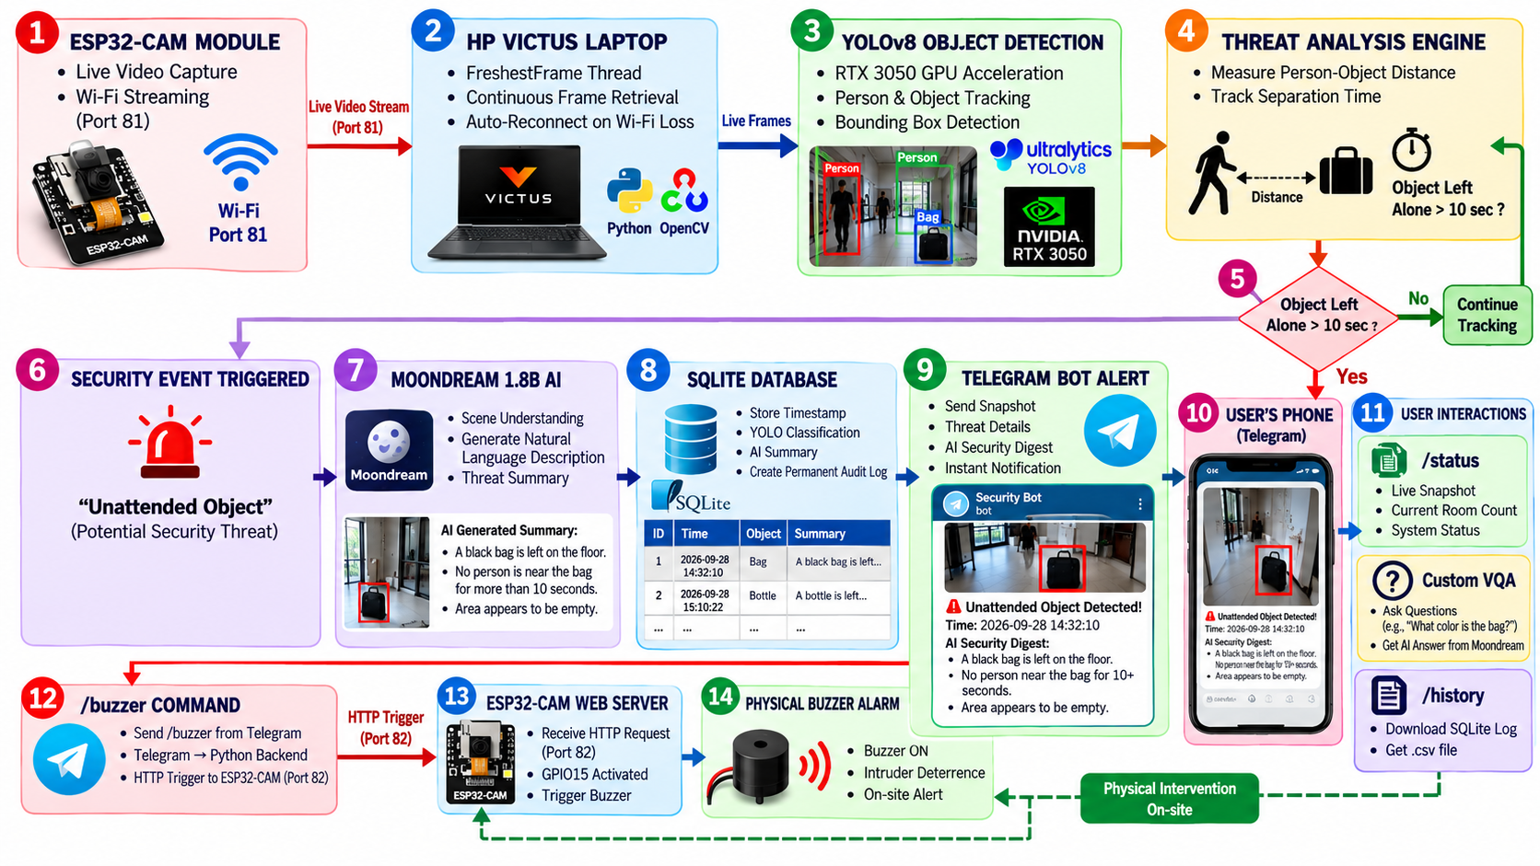
System Pipeline

Slide 8
System Advantages
1
Bandwidth Efficiency: Eliminates continuous video streaming to the cloud.
2
Semantic Context: Replaces blind motion alarms with detailed natural-language reports.
3
Data Privacy: 100% on-premise AI inference ensures zero sensitive data leakage.
4
Hardware Cost Reduction: Operates on sub-$10 edge hardware modules.
5
Bidirectional Control: Closed-loop capability allows remote intervention, not just observation.

Slide 9
Future Scope
Multi-Node Mesh Scalability: Expanding from a single ESP32-CAM to a synchronized, multi-camera edge network for continuous threat tracking across large facilities.
Facial Identity & Attribution: Upgrading the neural pipeline with facial embeddings to identify exactly who abandoned a detected object.
Automated Facility Intervention: Interfacing the central Python hub with building infrastructure (PLCs) to automatically lock electronic doors or trigger heavy machinery shutdowns during a validated threat.

Slide 10

Conclusion
The Autonomous Edge AI Security System successfully demonstrates a shift from passive observation to active, intelligent intervention.
Proves viability of 100% on-premise, cloud-free security.
Effectively mitigates network bandwidth and cloud storage costs.
Transforms raw pixels into actionable, conversational intelligence.

Slide 11



Thank You
Open for Queries.

